Slide 1
NBA ANALYSIS PROJECT
OMAR DUKUREH
Notes:
Hello my

Slide 2
Project Overview
This project aims to explore the opportunity to use historical data to predict player stats for future NBA seasons
It will aim to predict points, assists, rebounds, Turnovers, Steals, blocks.
The goal is to give teams, fantasy players, and sports analysts a tool to forecast season-long performances and to make smarter decisions

Slide 3

Proposed Vision
Collect and Clean the data from BasketBall-Reference.com
Feature engineering to add more advanced stats to accurately predict season averages.
Apply Linear regression to help predict season long stats from the input data.
Evaluating the predictions to see how accurate it is.

Slide 4
Estimated Impact
This project hopes to impact multiple groups in their decision making;
Fantasy sports : Helps users build smarter rosters and gain a competitive edge.
Sports Betting : More accurate season-long projections help sportsbooks set better odds.
NBA Teams & Analysts : Teams can use projections for better decision-making on trades, contracts, and player development.

Slide 5
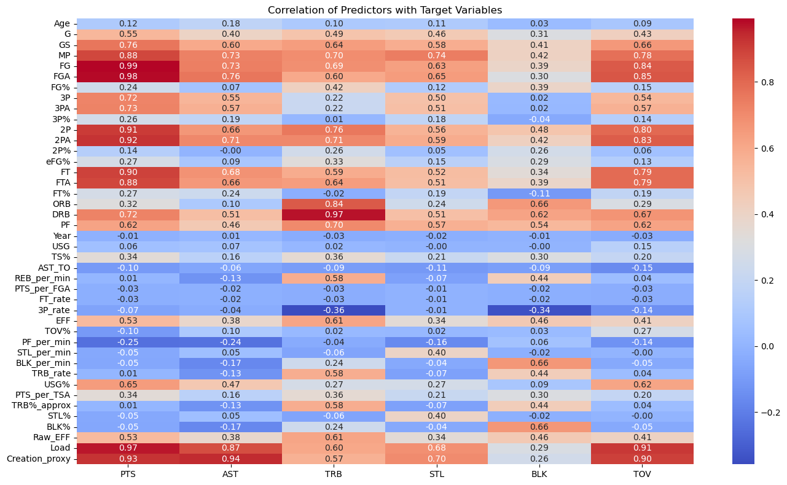
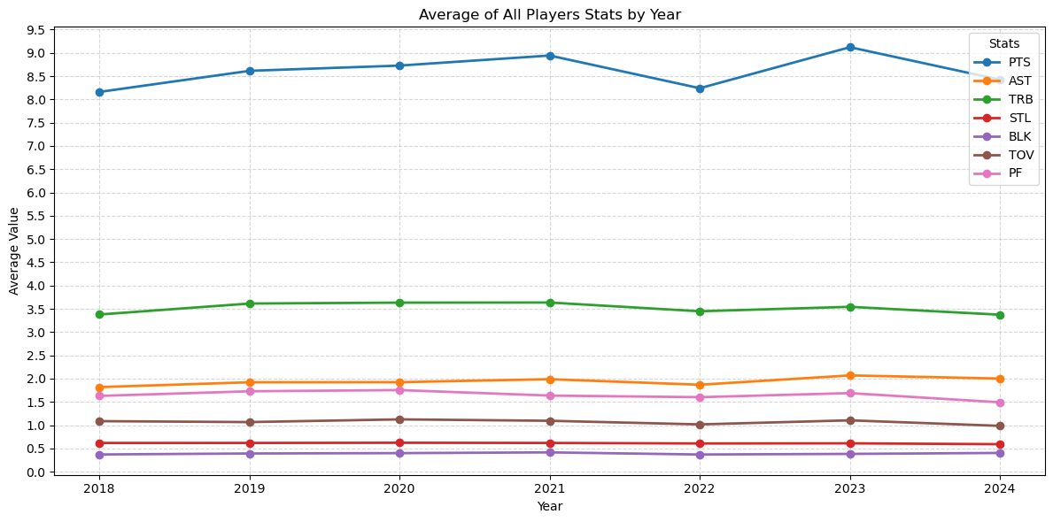
Data Overview
Data is sourced from Basketball-Reference, it contains data from the 2018 NBA season to 2024 NBA season.
There were missing values but since the amount was less than 5% of the data, I dropped them.
The heat map shows correlation between what I want to predict and the variables that are going to help predict.
From the Correlation heatmap, age is not really correlated with, Points is highly correlated with many of the features.
The averages of players’ stats remain stable over time, with no significant increase or decrease.
Notes:
The Creation Proxy is a metric designed to estimate how much offensive playmaking or shot creation a player is responsible for, Load is a blend of a players contribution to a possession.

Slide 6
Future Work
Creating a linear regression/XGBoost model to accurately predict season averages
Adding more analytical data to help with predictions
Evaluating R^2 for the models and Normality of the predictions
Creating a prediction data frame to compare with actual stats for the 2025 NBA season

Slide 7
THANK YOU!

